Slide 1
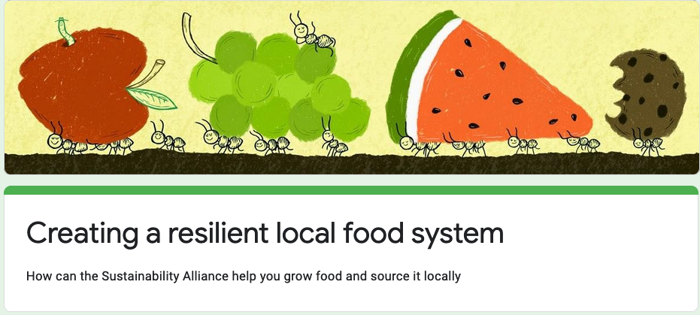

Food Survey OF Covid -19
By - SURENDRA KUMAR UPADHYAY

Slide 2
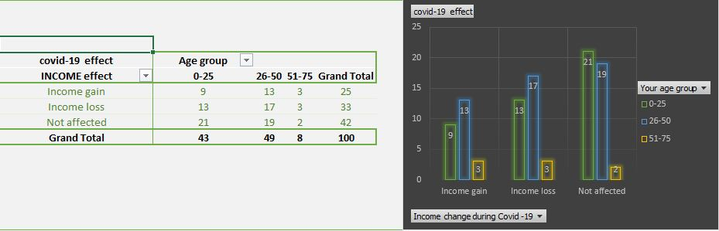
Income effected by different age group people during covid-19

Slide 3
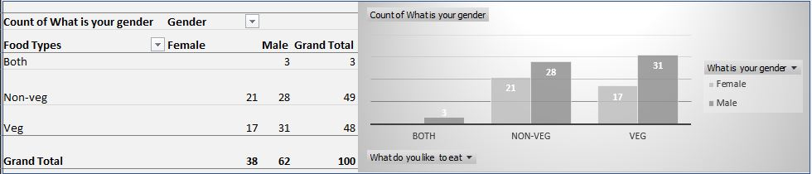
How many people eat veg and non-veg

Slide 4
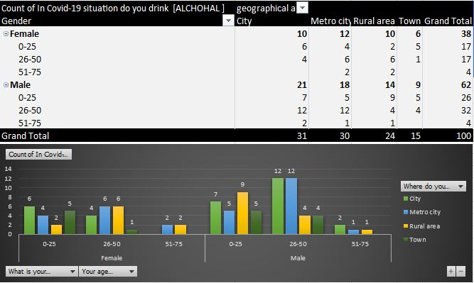
User of alcohol as per city and gender wise

Slide 5
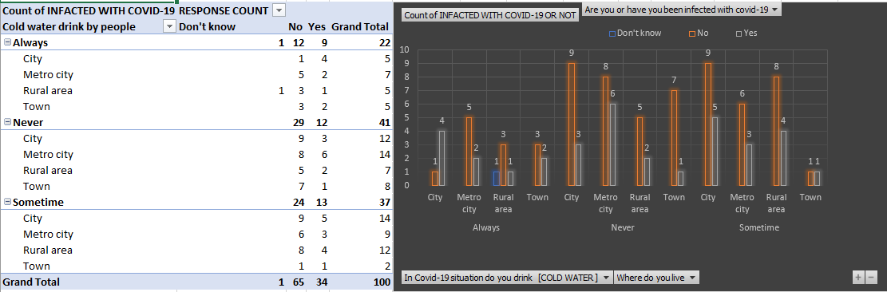
People infected with covid-19 and drink cold water as per geographical area

Slide 6
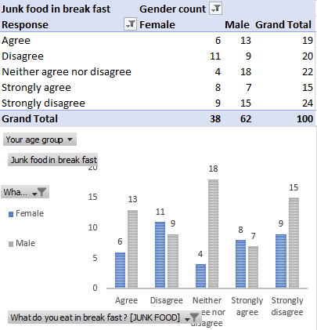
People like to eat junk food in breakfast

Slide 7
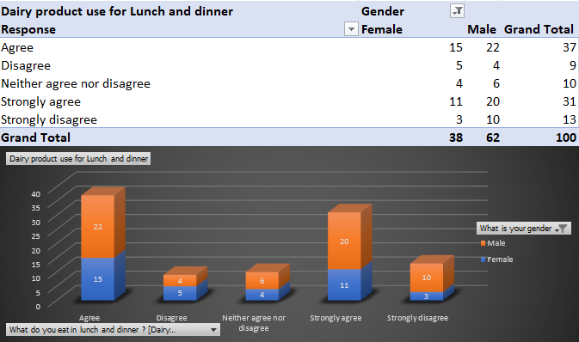
People use dairy products for lunch and dinner

Slide 8
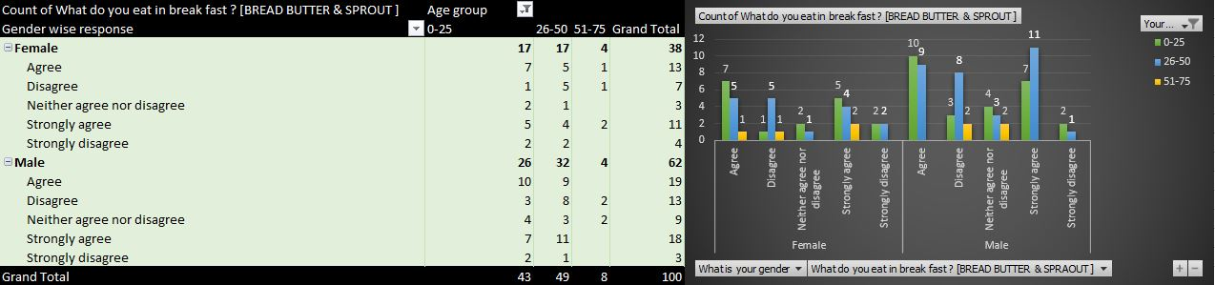
People eat bread butter & sprout in the breakfast

Slide 9
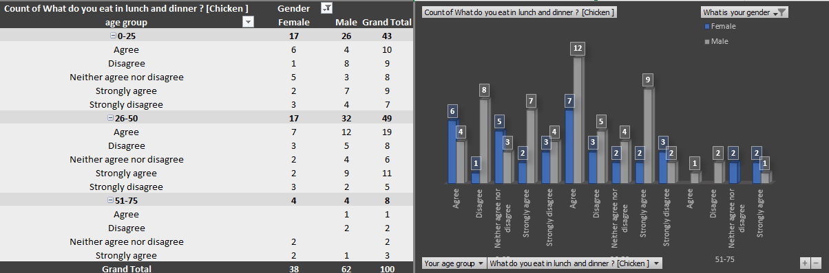
Describe the people who eat chicken as per gender wise and age group

Slide 10
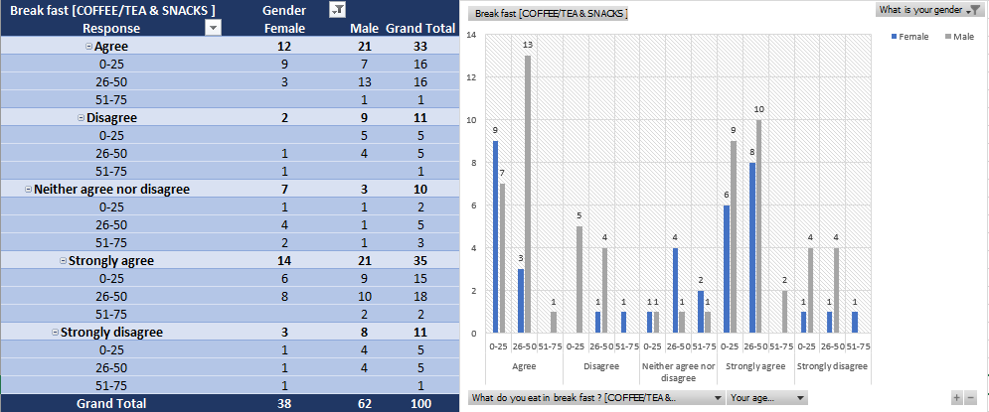
Breakfast with tea & coffee as per gender and age group wise

Slide 11
Income gain how many people have chronical illness
Income change during Covid -19 | Income gain
Count of Do you have any chronic illness
location wise | No | Yes | Grand Total
City | 1 | 6 | 7
Metro city | 5 | 2 | 7
Rural area | 5 | 3 | 8
Town | 3 |  | 3
Grand Total | 14 | 11 | 25

Slide 12
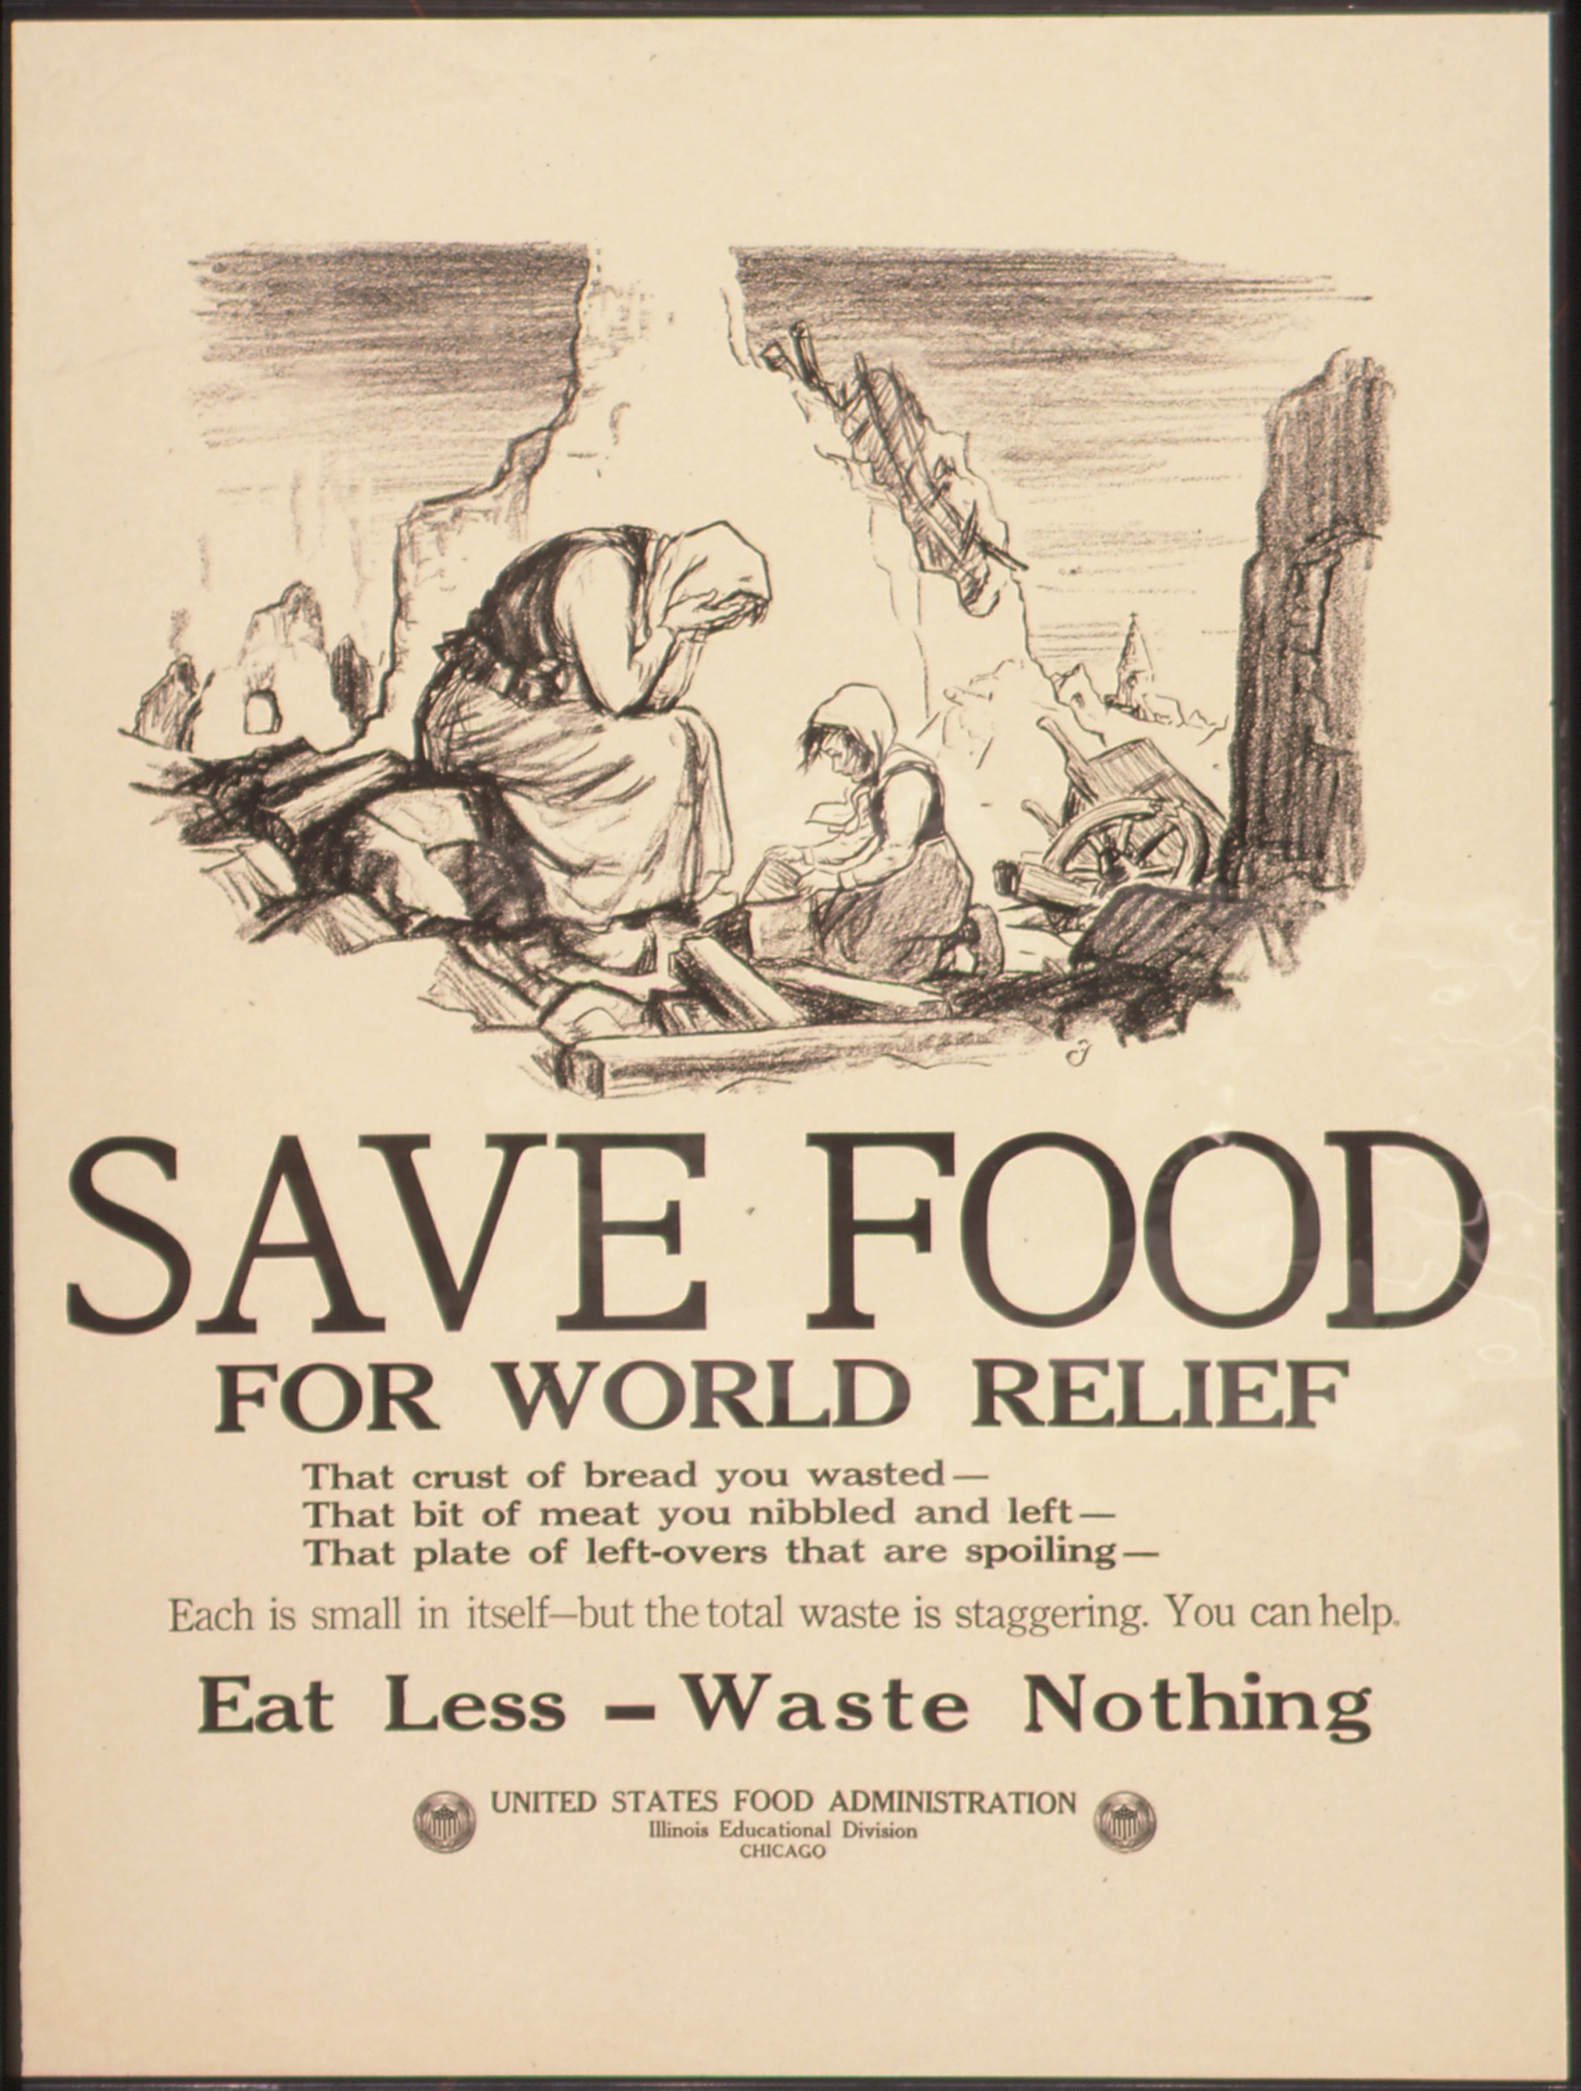
THANK YOU
This Photo by Unknown Author is licensed under CC BY-SA

